Slide 1




LENDI INSTITUTE OF ENGINEERING AND TECHNOLGOY
(Autonomous)
Approved by AICTE and Permanently affiliated to JNTU Gurajada-Vizianagaram.
ECE,EEE,CSE&MECH
DEPARTMENT OF COMPUTER SCIENCE AND ENGINEERING
NAME OF THE SUBJECT :
NAME OF THE TOPIC :
PRESENTED BY :
Mr. N P PATNAIK M
Assistant Professor

Slide 2
CI/CD: Continuous Integration and Continuous Delivery
Planning –Documenting and determining project structure and schedule.
Analysis –Analyzing project requirements and collecting resources.
Design –Designing software model with architecture and Interface designing.
Implementation –Developing an actual product by considering design and requirements.
Testing –Testing the built, fixing errors & bugs, and refactoring the code.
Deploying and Maintenance –The software is deployed and monitored for further enhancements.

Slide 3
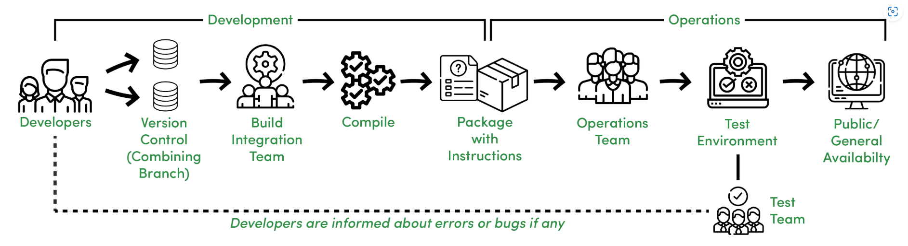

Slide 4
Features –
An overview of a Traditional SDLC shown in the above image works in the following manner.
Different Development teams maintain different code repositories.
Build and Integration team integrates the code.
Integrated code is compiled as a package.
A package with instructions is sent to the Operations team.
The Operations team pushes the package into a test environment, the package is tested by the Testing team.
The Test team informs the Development team about any possible issues else gives a green signal for Production Release.
Notes:
Features –
An overview of a Traditional SDLC shown in the above image works in the following manner.
Different Development teams maintain different code repositories.
Build and Integration team integrates the code.
Integrated code is compiled as a package.
A package with instructions is sent to the Operations team.
The Operations team pushes the package into a test environment, the package is tested by the Testing team.
The Test team informs the Development team about any possible issues else gives a green signal for Production Release.

Slide 5
CI/CD Definition :
CI/CD stands for Continuous Integration and Continuous Delivery (or Continuous Deployment), it is about how an Integrated code on a shared repository is used to release software to production multiple times a day with the help of automation.”

Slide 6
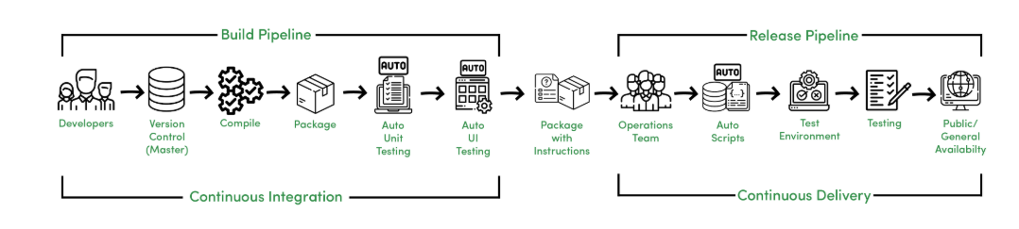
Continuous Integration :
Continuous Integration is about how developers integrate code using a shared repository multiple times a day with the help of automation.
Continuous Delivery :
Continuous Delivery is about automatically releasing software to the test or production environment.

Slide 7
Continuous Deployment :
Continuous Deployment is about releasing software to production automatically without human intervention.
Continuous Deployment is an advancement and it reduces manual work of the Operations and Testing team to deploy the software to production as it is automatically deployed to production after Automated Acceptance Testing.

Slide 8
Features –
CI/CD helps for rapid and reliable software development in the following manner.
Automated and quick code integration.
Error detection and response are fast due to the short cycle and iterations.
Less prone to human errors.
Faster than following manual instructions due to automated scripting.
Deployment can be done several times a day.

